Slide 1
SAM. Limits of Operation.
Case Study Of Intelligent System In Production
Prof. Tim Weber
Group 1
1. Ranveer Patil
2. Shokhrukh Khamidov
3. Nevil Rafaliya
4. Naimish Savaliya
5. Zeel Navadiya

Slide 2
Outlines
SAM Introduction and Principle
Software
Objective
Results – Turbidity sensor
Results – Scans (WinSAM)
Conclusion

Slide 3
SAM Introduction and Principle
Introduction:
Scanning Acoustic Microscopy (SAM) is a non-destructive imaging technique used to analyze the internal structure and properties of materials at micrometer and nanometer scales.
It utilizes high-frequency ultrasound waves to inspect materials, providing detailed information about their internal features such as defects, microstructure, and material properties.
Principle:
SAM operates on the principle of acoustic microscopy, where ultrasonic waves are generated and transmitted into the material being studied.
A transducer generates high-frequency sound waves (typically in the range of tens to hundreds of megahertz), which are focused onto the sample surface.
These sound waves travel through the material, and their interaction with internal features such as interfaces, inclusions, or defects causes reflection, scattering, or diffraction of the waves.

Slide 4
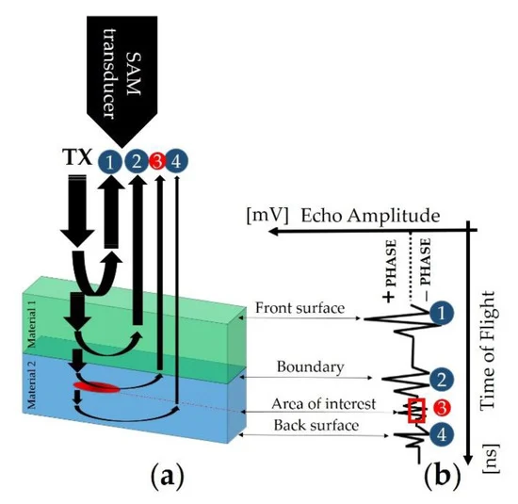
Transducer emits ultrasonic waves into the direction of material, waves hit the surface externally and internally and reflect back to the transducer.
Echoes are created and are being read by sensor.
https://www.mdpi.com/1424-8220/19/22/4868

Slide 5
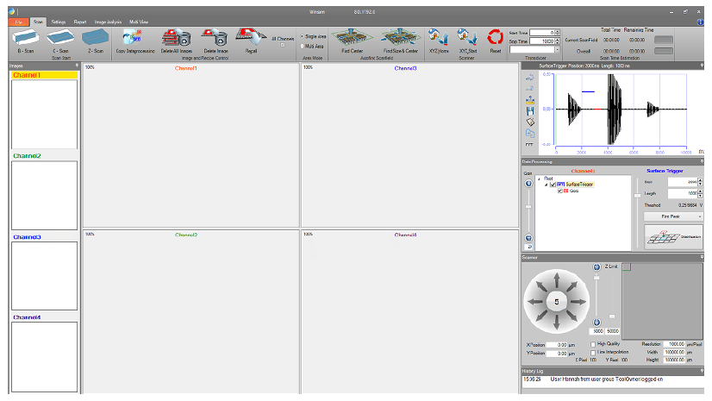
Software: SAM => WinSAM
Generally, it handles advanced image analysis, provides a defect detection functionality,
size and position analysis.
A-scans, B-scans and C-scans.
Serves as a main conjunction tool with SAM equipment.

Slide 6
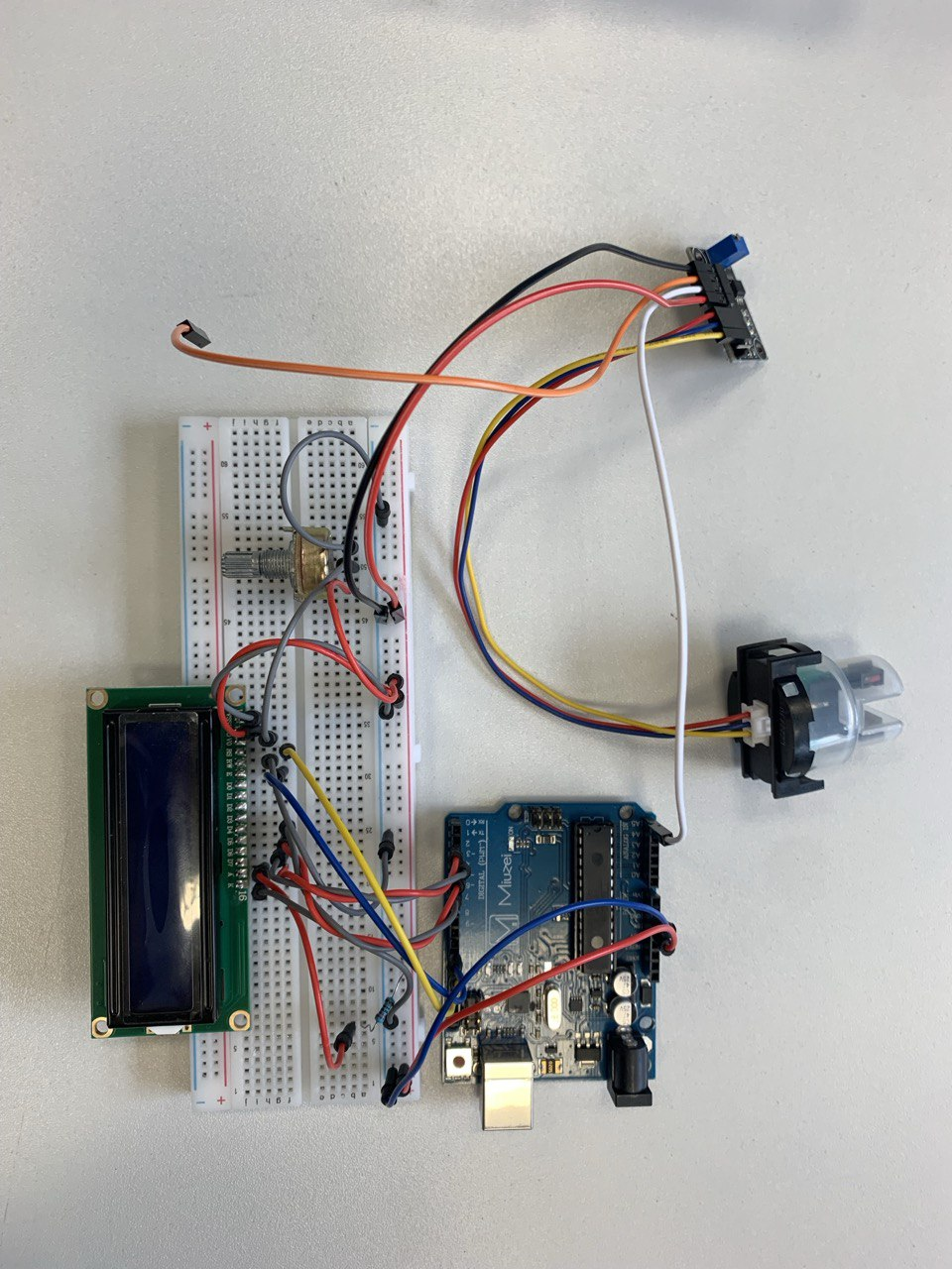
Objective
The primary objective of our project is to define limits of process
Determine the main factors that affect the effectiveness of sample scaning
Additionally, we aim to create a interface for visualizing and understanding turbidity, enhancing accessibility for users.

Slide 7
Results – Arduino Turbidity meter
Mapping: 0-10 units, where 0 – the lowest turbidity, 10 – the highest.
First day / Fresh distilled water: 9.1.
2 weeks later / Aged water: 8.8
There is a difference, but very small -> 3% change.

Slide 8
Results – WinSAM Scan
Fresh water – 10/06/2024

Slide 9
Results – WinSAM Scan
2 weeks – 25/06/2024
Significant changes

Slide 10
Conclusion
Simplisitc Turbidity meter fails to capture significant changes.
It may sense the tiny difference, however more advanced sensor tools are required.
WinSAM is extremely vulnerable for water pollution.
For accurate result – water has to be changed every time.

Slide 11
Thank You

